Slide 1
Front End Engineering-I Project
Team Details: Shiwang Sharma
Jainish Jindal
Sarthak Kanwar
Suryansh Tangra
Faculty Coordinator: Vaibhav Sultane
:
Chitkara University Institute of Engineering and Technology,
Chitkara University, Punjab

Slide 2
Table of Contents
Introduction
Problem Statement
Technical Details
Key Features
Project Highlights
Bonus Feature(optional)
Conclusion
References/Links used

Slide 3
Introduction
Platform Overview
This platform offers a diverse range of courses across multiple categories, including Science, Technology, Personal Development, and more.
For Instructors:
Add courses, lessons, and quizzes.
Create and manage learning content.
For Students:
Enroll in courses.
Study lessons, take quizzes.
Earn certifications upon completion.

Slide 4
Problem Statement
Time Wastage: Traveling to a physical location for learning.
Geographical Limitations: Limited access to quality education based on location or availability of courses..
Inconvenience: Missing lectures and missing out on important content.
Solution: LearnWise
Study from the comfort of your home, whenever and wherever you want.
Enjoy easy access to a vast range of courses with just a click.
Learn at your own pace, without the constraints of traditional classrooms.

Slide 5
Technical Details
Our platform, built with modern web development and Python, offers:
Front-End: HTML, CSS, JavaScript, Bootstrap
Back-End: Python
Database: SQL, DBSQULITE
Security: HTTPS
Interactivity: Quizzes, assignments, forums
Personalization: Machine learning for recommendations, progress tracking.
Deployment: GitHub
.

Slide 6
User-Friendly Interface
Wide Course Selection
Interactive Learning
Personalized Recommendations
Progress Tracking
Secure Access
Responsive Design
Instructor Tools
Scalability
Key Features

Slide 7
Project Highlights
Innovative Platform: Combines modern web technologies with Python for a robust and scalable solution.
User-Friendly Design: Intuitive interface enhances the learning experience and encourages engagement.
Diverse Course Offerings: Wide range of courses across various disciplines to cater to different interests.
Interactive Features: Quizzes, assignments, and discussion forums to foster active learning.
Secure and Accessible: Strong authentication methods and responsive design ensure secure, global access.
Instructor Support: Tools for creating and managing engaging course content.

Slide 8
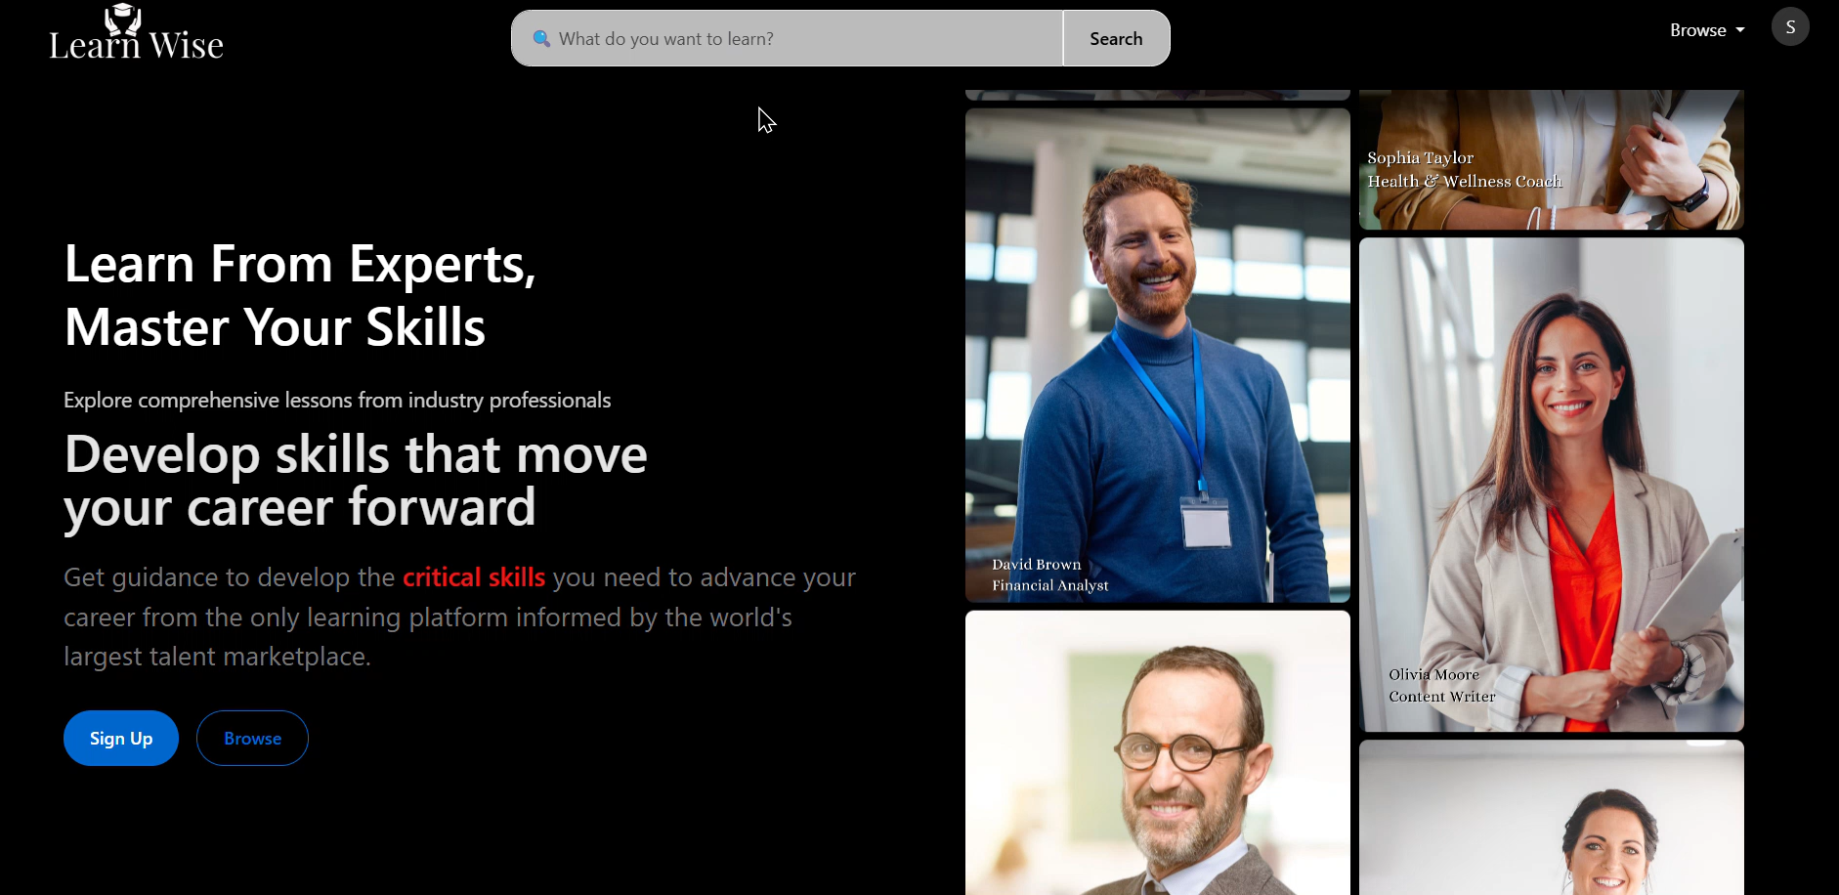
Project Highlights
Home Page:

Slide 9
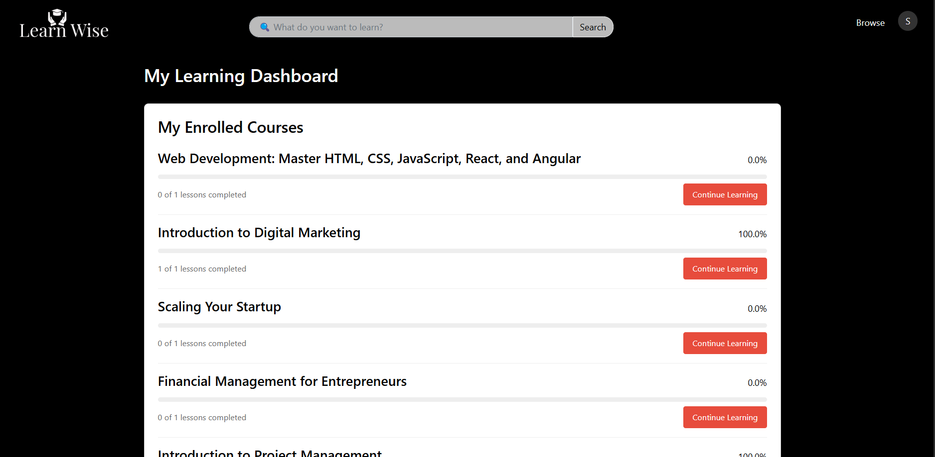
Project Highlights
Student Dashboard:

Slide 10
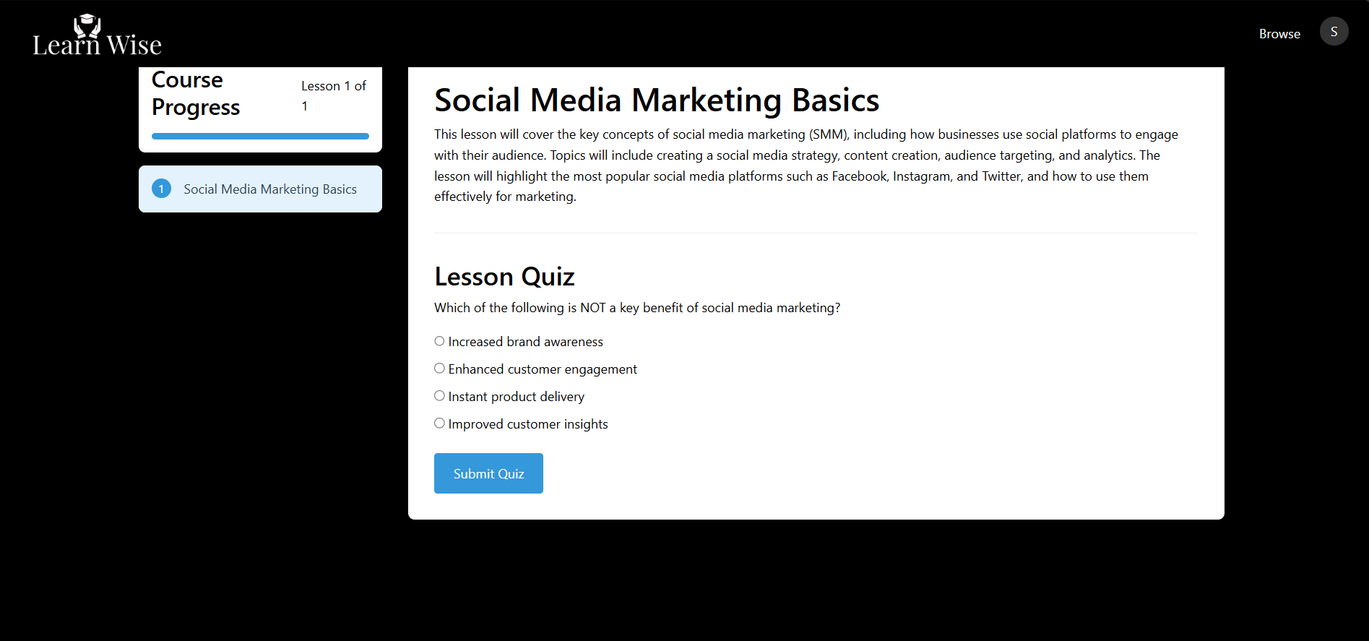
Project Highlights
Student Course View Page:

Slide 11
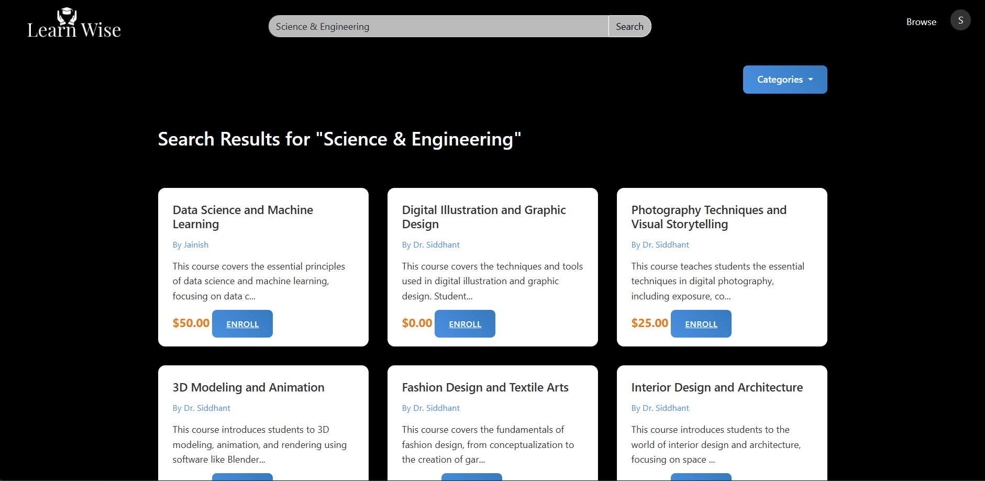
Project Highlights
Browse Page:

Slide 12
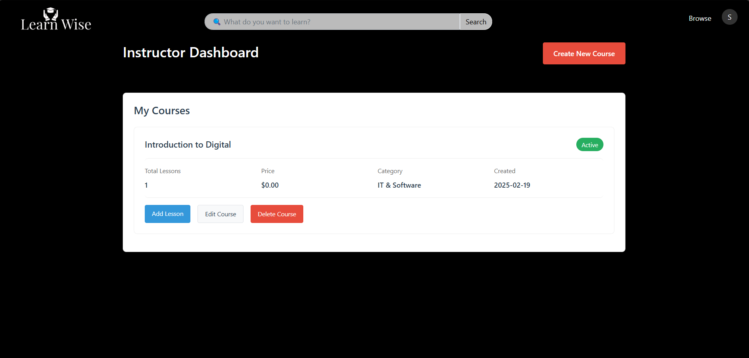
Project Highlights
Instructor Dashboard:

Slide 13
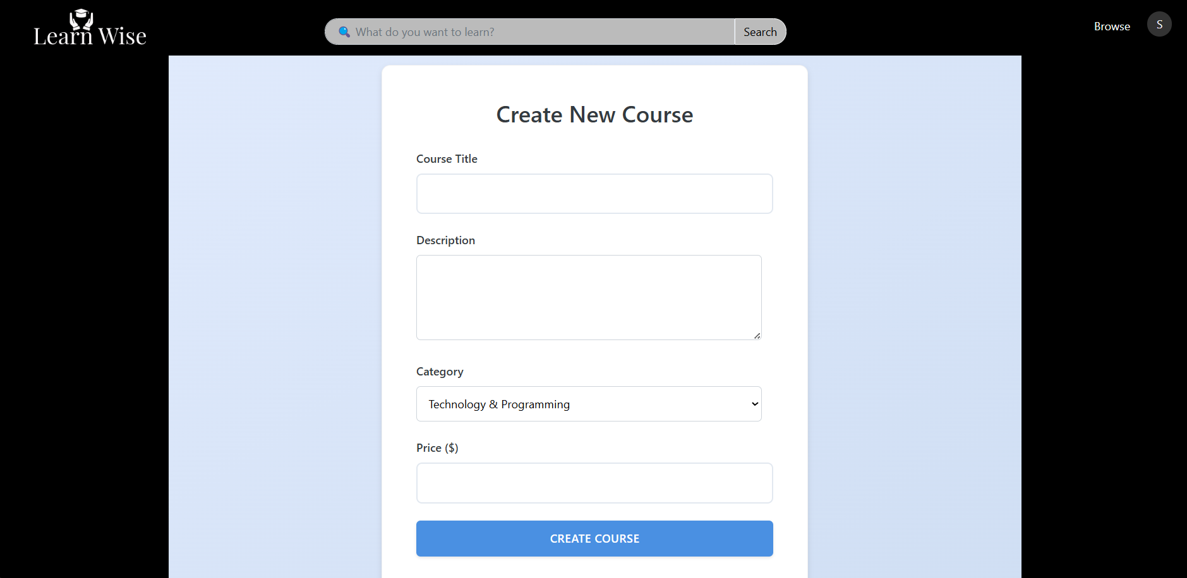
Project Highlights
Instructor Course Create Page:

Slide 14
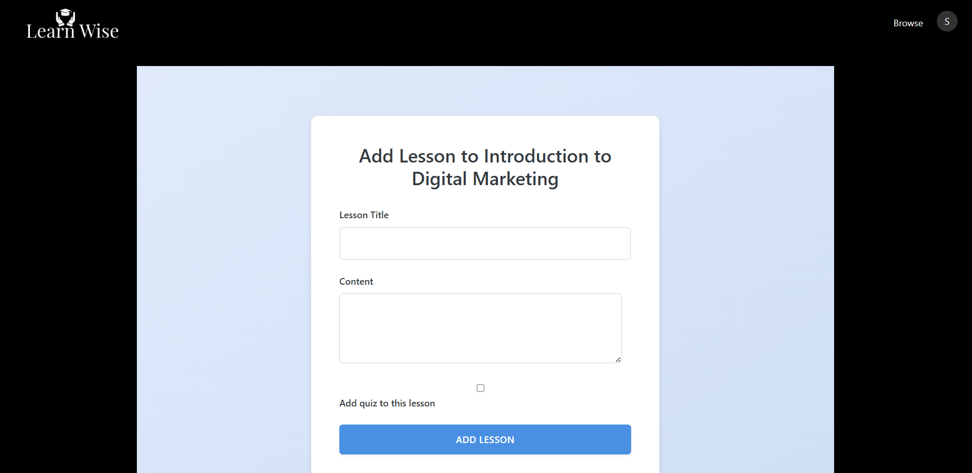
Project Highlights
Instructor Lesson Adding Page:

Slide 15
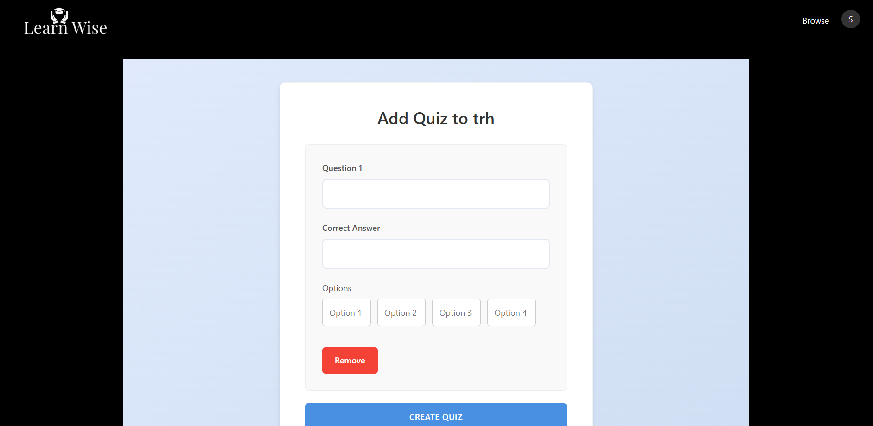
Project Highlights
Instructor Quiz Adding Page:

Slide 16
Bonus Feature(optional)
1 Admin Dashboard
Feature: Admin can manage users, courses, and track site activity.
Implementation: Create a restricted admin panel where admins can monitor the platform.
2 User Profile and Settings
Feature: Allow users (students and instructors) to update their profiles, including password changes, and upload profile pictures.
Implementation: Add an edit profile page where users can change their information
3 Lesson Completion and Quiz Scoring
Feature: Allow students to mark lessons as complete and take quizzes. The system could track quiz scores.

Slide 17
Conclusion
Our online course platform is designed to meet the demands of today's learners, providing a seamless, engaging, and personalized learning experience. By leveraging modern web technologies and Python, we've created a robust and scalable solution that caters to diverse interests and learning styles. With a user-friendly interface, interactive features, and strong security measures, our platform ensures a comprehensive and enjoyable learning journey for users worldwide.

Slide 18
Web Development:
: Comprehensive documentation and guides on HTML, CSS, and JavaScript.
: Tutorials and resources for learning and mastering
Python:
: Complete reference for Python programming.
Database Management:
: Detailed information on using and administering SQL.
Deployment:
: Guides and references for containerizing applications.
: Resources for deploying and managing applications on AWS.
Machine Learning:
: Resources for implementing machine learning algorithms.
General Resources:
: Community-driven Q&A platform for developers.
: Code hosting and collaboration platform.
References/Links used

Slide 19


